Slide 1

Chicago Crime Data Analysis
Presented by:
Group1 – Elena, Natalie, Arpneet, Suraj, Vasu, Chulin

Slide 2
Is Chicago is Safe Place to travel or live?
Chicago is known for its relatively high average crime rate. However, if someone has to travel in Chicago a great research is required to find the better safe places.
Moreover, many evidences of increasing can be accumulated due to migration of people within Chicago due to increased number of crimes.
Therefore, the concern on crime is really essential for Police of Chicago to look in, and to make it a more safer place for the people living in Chicago and for those coming to explore.

Slide 3
To make Chicago a better place for living, we analyzed crime data to find out measures that can help in reducing the crime in Chicago.

Slide 4
1. Data Preprocessing
1. Examination of dataset
Length of dataset – 7690564 rows
30 columns
The names of the features : ID, Case Number, Date, Block, IUCR, Primary Type, Description, Location Description, Arrest, Domestic, Beat, District, Ward, Community Area, FBI Code, X Coordinate, Y Coordinate, Year, Updated On, Latitude, Longitude, Location, Historical Wards 2003-2015, Zip Codes, Community Areas, Census Tracts, Wards, Boundaries - ZIP Codes, Police Districts, Police Beats

Slide 5
1. Data Preprocessing
1. Examination of dataset
The given data provides us the information on various parameters of the crime.
Starting with, Primary Type describes the type of crime happening in Chicago.
For example - Theft, Criminal Damage, Narcotics, Motor Vehicle Theft, etc.
IUCR represents the crime code as per the legal authorities.
Date column describes the date and time when the crime actually happened and reported.
Description provides the overview of crime by providing a brief analysis.
Location Description tells the general place where the crime happens in Chicago.
Arrest column describe if the criminal has been arrested or not.
District, Ward, Community Area, X and Y Coordinate, Latitude and Longitude all parameters help in identifying the exact point where the crime has happened.
Police Districts and Police Beats describe the presence of Police specific to the location.

Slide 6
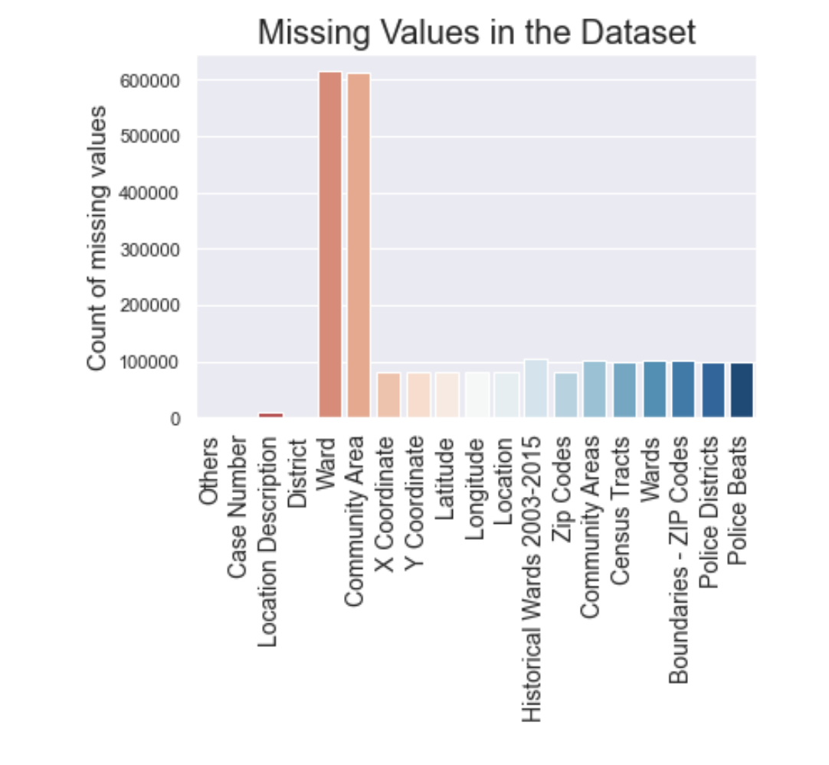
2. Data Cleaning
Identify Missing Values in Data
The missing values in the dataset are:
Case Number (text datatype) : the Chicago Police Department RD Number (Records Division Number), which is unique to the incident.
Location Description (text datatype) : description of the location where the incident occurred.
District (text datatype) : Indicates the police district where the incident occurred.
Ward (number datatype) : the ward (City Council district) where the incident occurred.
Community Area (text datatype) : indicates the community area where the incident occurred. Chicago has 77 community areas.
Latitude (number datatype) : the latitude of the location where the incident occurred. This location is shifted from the actual location for partial redaction but falls on the same block.
Longitude (number datatype) : the longitude of the location where the incident occurred. This location is shifted from the actual location for partial redaction but falls on the same block.
The rest of the missing values of the features is less important because they are not included in this analysis.

Slide 7
How much of the data has been retained after this removal ?
Dropping the rows will usually result in clean datasets and produce well-behaved data. But in this case, it removes a lot of information (around 9%) that might reduce result accuracy. Therefore, since only 91% of the data is retained, and the data set might diminish, we will not drop the rows with missing values.
Instead of dropping corresponding rows that contain nulls, we choose to replace nulls and exclude such values from our specific analysis if needed. If we drop an observation based on incomplete information (e.g. missing location), we might lose valuable information (e.g. crime event counts).

Slide 8
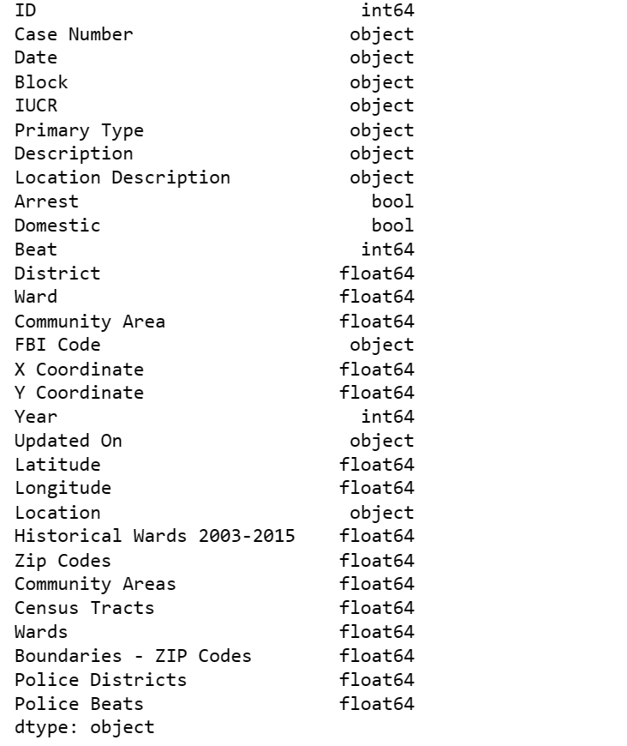
Dataset transformation
We can clearly see that the following columns have been loaded with defaults, in terms of their data type:
Date: data type is str, should be datetime64
District: data type is float64, should be int64
Ward: data type is float64, should be int64
Community Area: data type is float64, should be int64
We have converted the columns to appropriate datatypes for alignment with original dataset types and better performance gains.

Slide 9
Exploratory Data Analysis

Slide 10
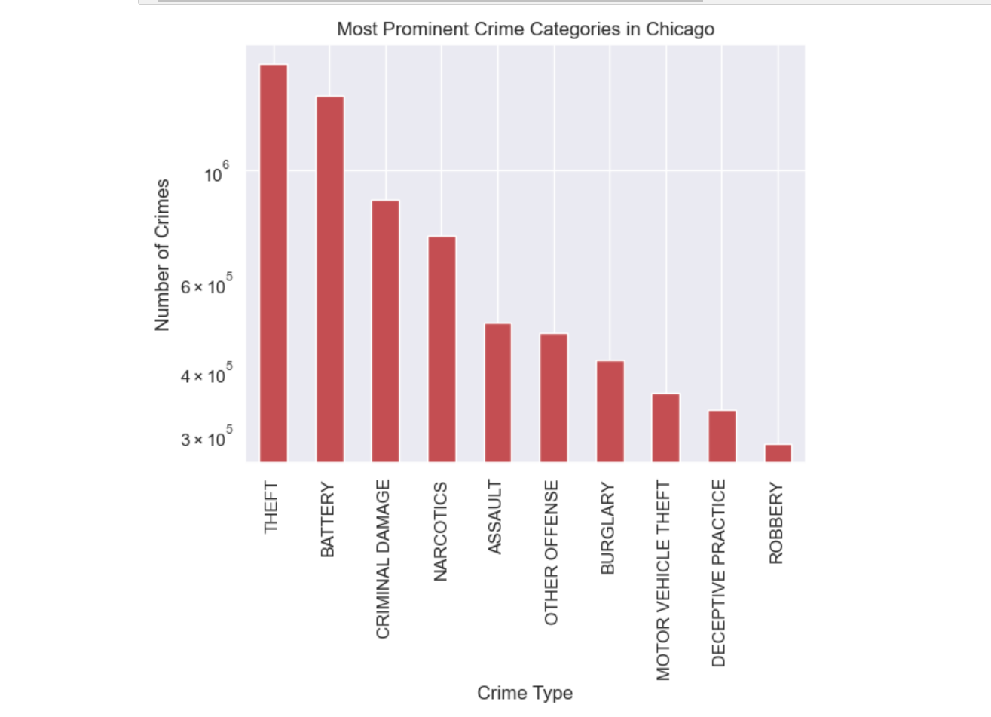
Overall Crime Trends in Chicago
The top 5 categories of crime are: THEFT, BATTERY, NARCOTICS, CRIMINAL DAMAGE, and ASSAULT.

Slide 11
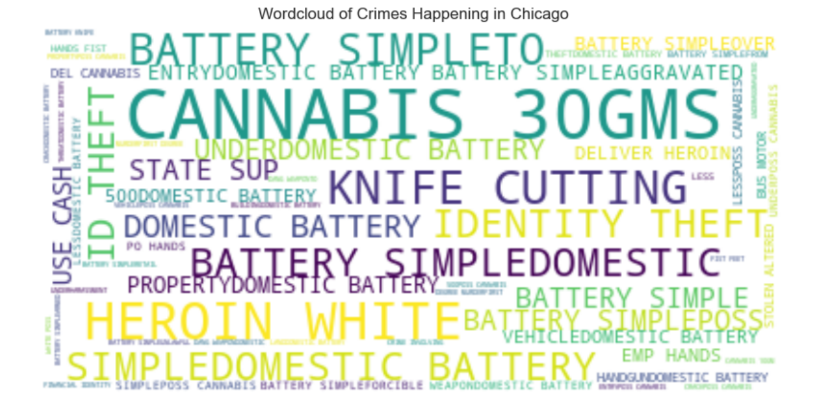
Overall Crime Trends in Chicago
It was found that top 5 crimes occurring in Chicago are: SIMPLE THEFTS, USD 500 AND UNDER, DOMESTIC BATTERY SIMPLE, TO VEHICLE, THEFT of OVER USD 500.

Slide 12
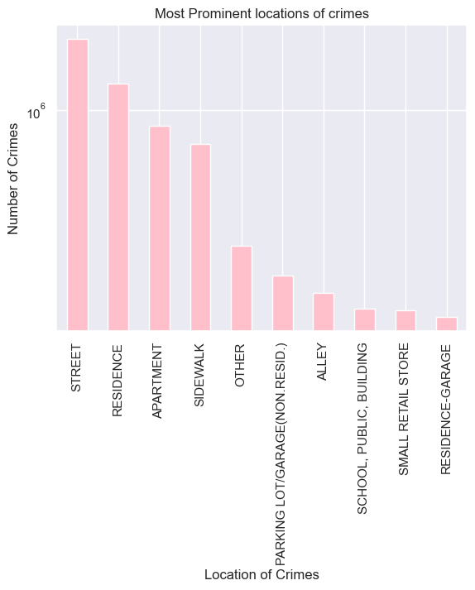
Overall Crime Trends in Chicago
It was found that top 5 crime locations in Chicago are: STREET, RESIDENCE, APARTMENT, SIDEWALK, OTHER.

Slide 13
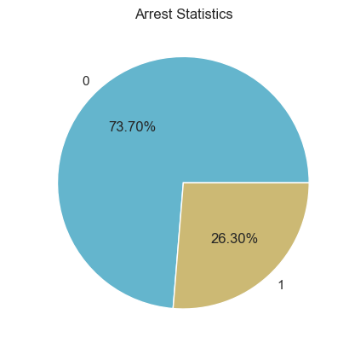
Overall Crime Trends in Chicago
It was found that only one-third of the people who commit crime got arrested by the police.

Slide 14

Overall Crime Trends in Chicago
This chart quickly tells us which avenues to avoid in Chicago due to the higher frequency of crime occurrence. The most prominent crime locations are - Michigan Ave, Halsted St, Ashland Ave, State St, Madison St, Pulaski Rd, Luther King, Martin Luther, Western Ave

Slide 15
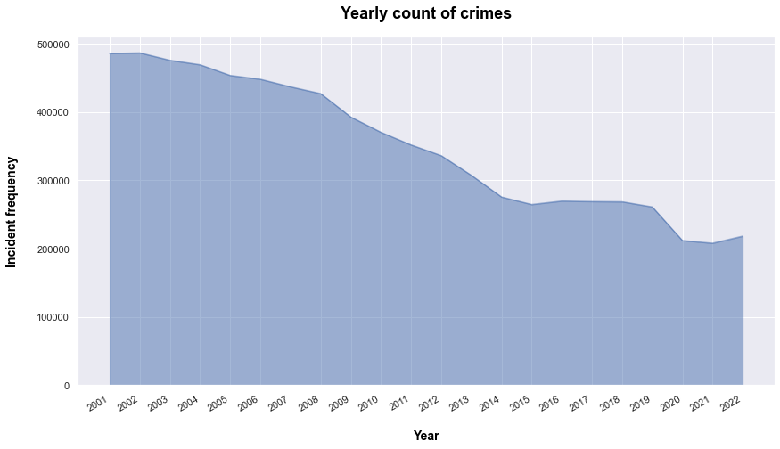
Overall Crime Trends in Chicago
From the trend above, we can see that the frequency of crimes in Chicago is decreasing over the years.

Slide 16
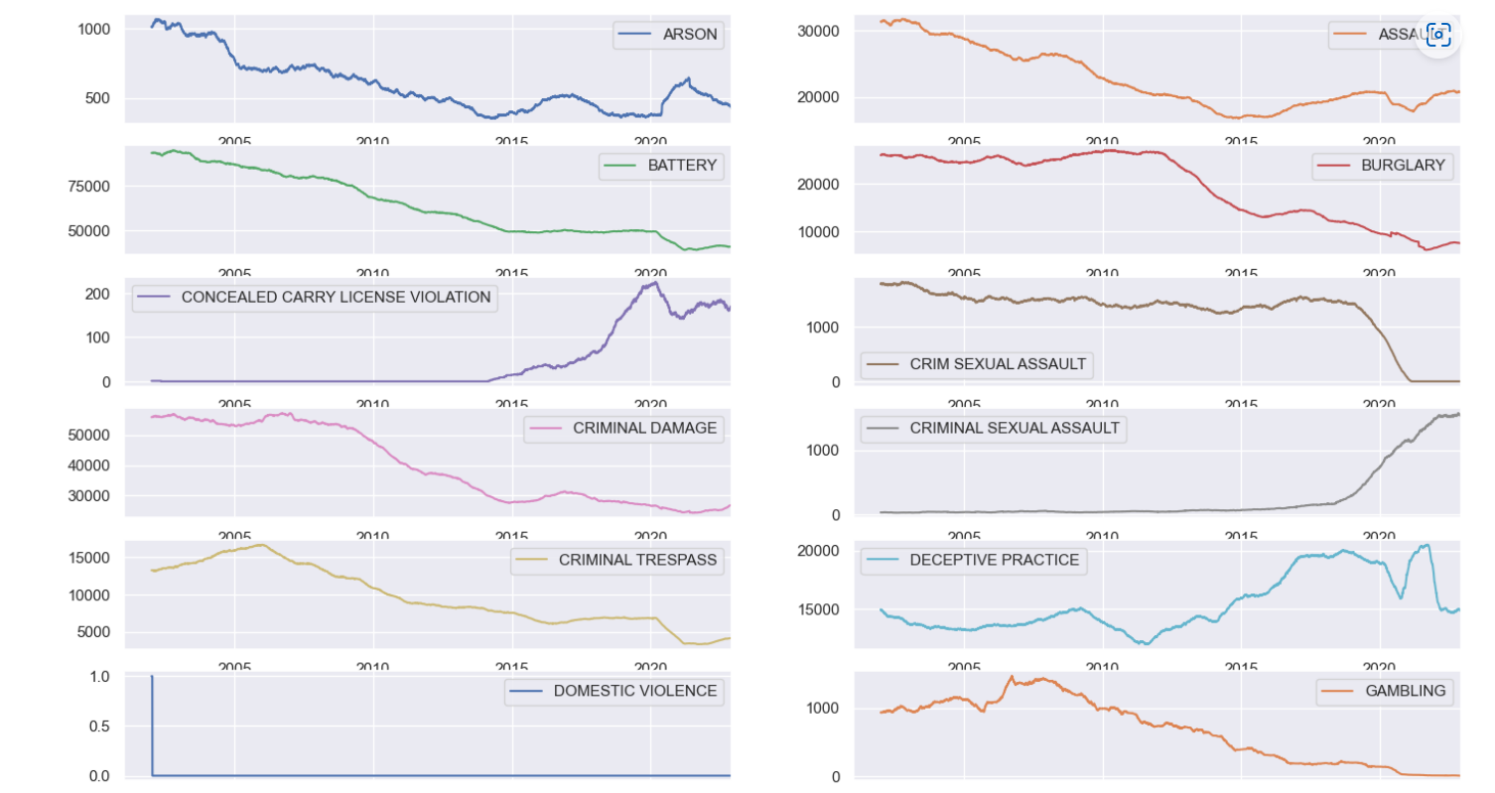
Detailed analysis of each category of crime over the years

Slide 17
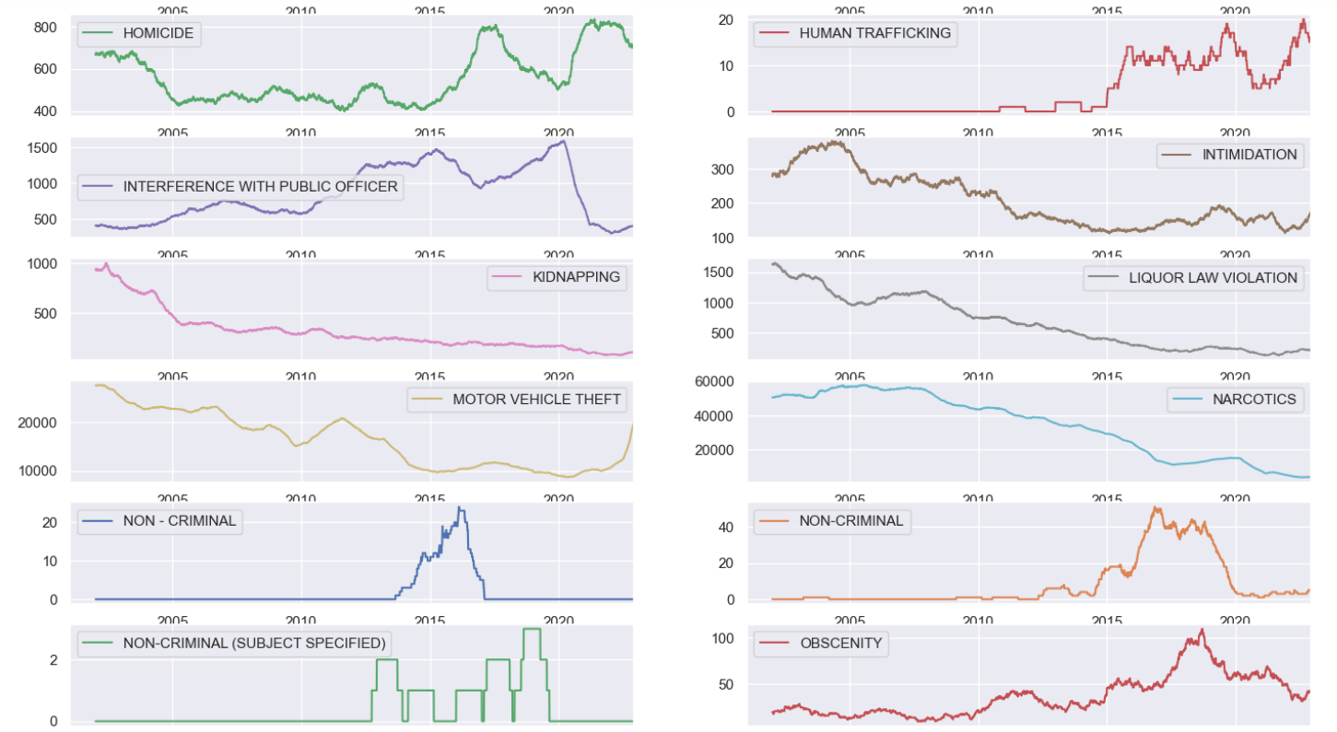
Detailed analysis of each category of crime over the years

Slide 18
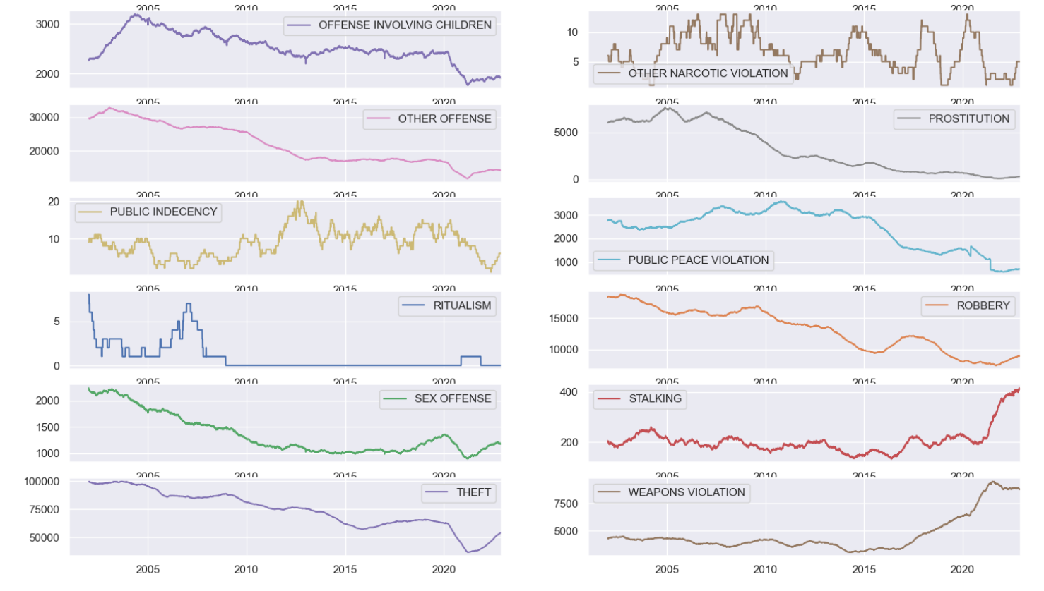
Detailed analysis of each category of crime over the years

Slide 19
Detailed analysis of each category of crime over the years
Although overall crime rate is decreasing. However, on the detailed analysis I found that in some categories it is increasing. Listing the crime categories which are increasing over time.
THEFT
WEAPONS VOILATION
STALKING
MOTOR VEHICLE THEFT
CRIMINAL SEXUAL ASSAULT
HUMAN TRAFFICKING
HOMICIDE
ARSON
SEX OFFENCE
CONCEALED CARRY

Slide 20
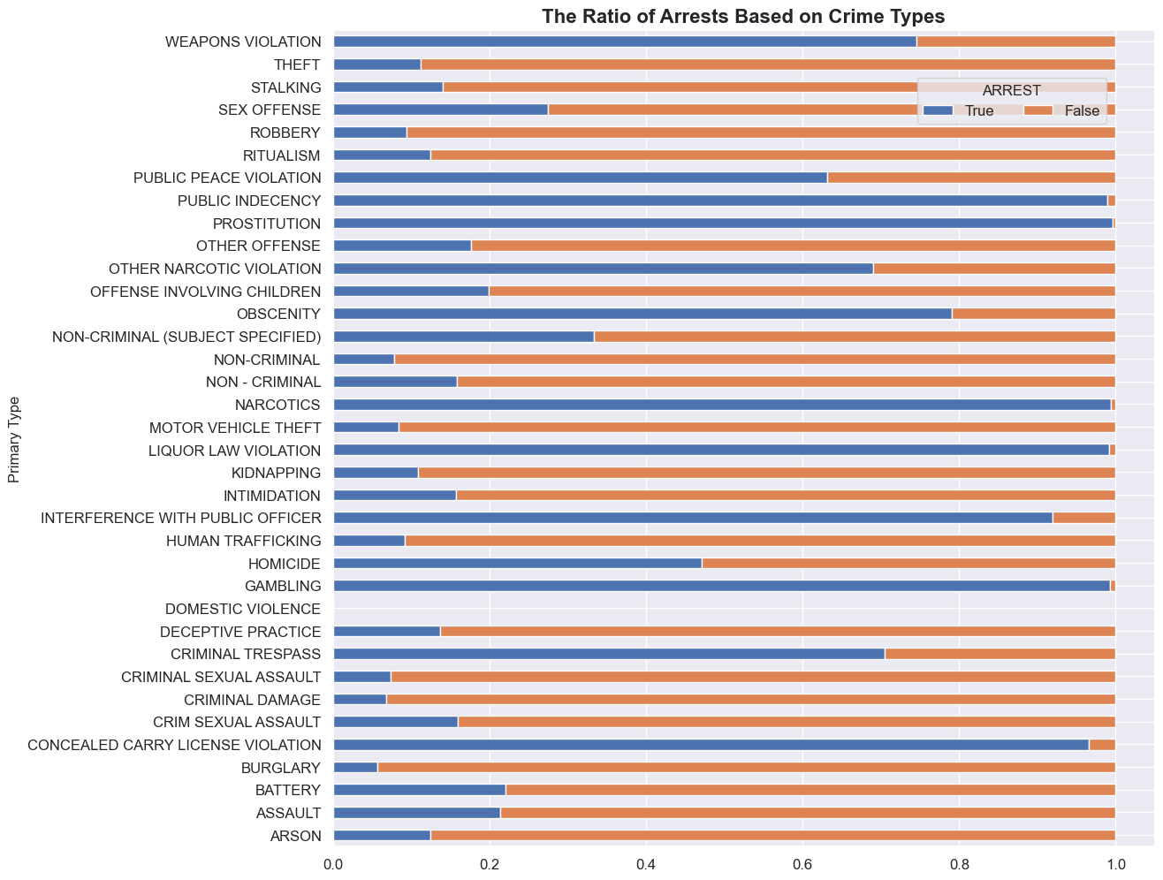
Ratio of Arrests Based on Crime Types
It can be concluded that for the most prominent crimes which are THEFT, BATTERY,CRIMINAL DAMAGE, and ASSAULT, the proportion of arrest with respect to crime is very less. However, one exception is there for NARCOTICS, where its proportion is quite high.

Slide 21
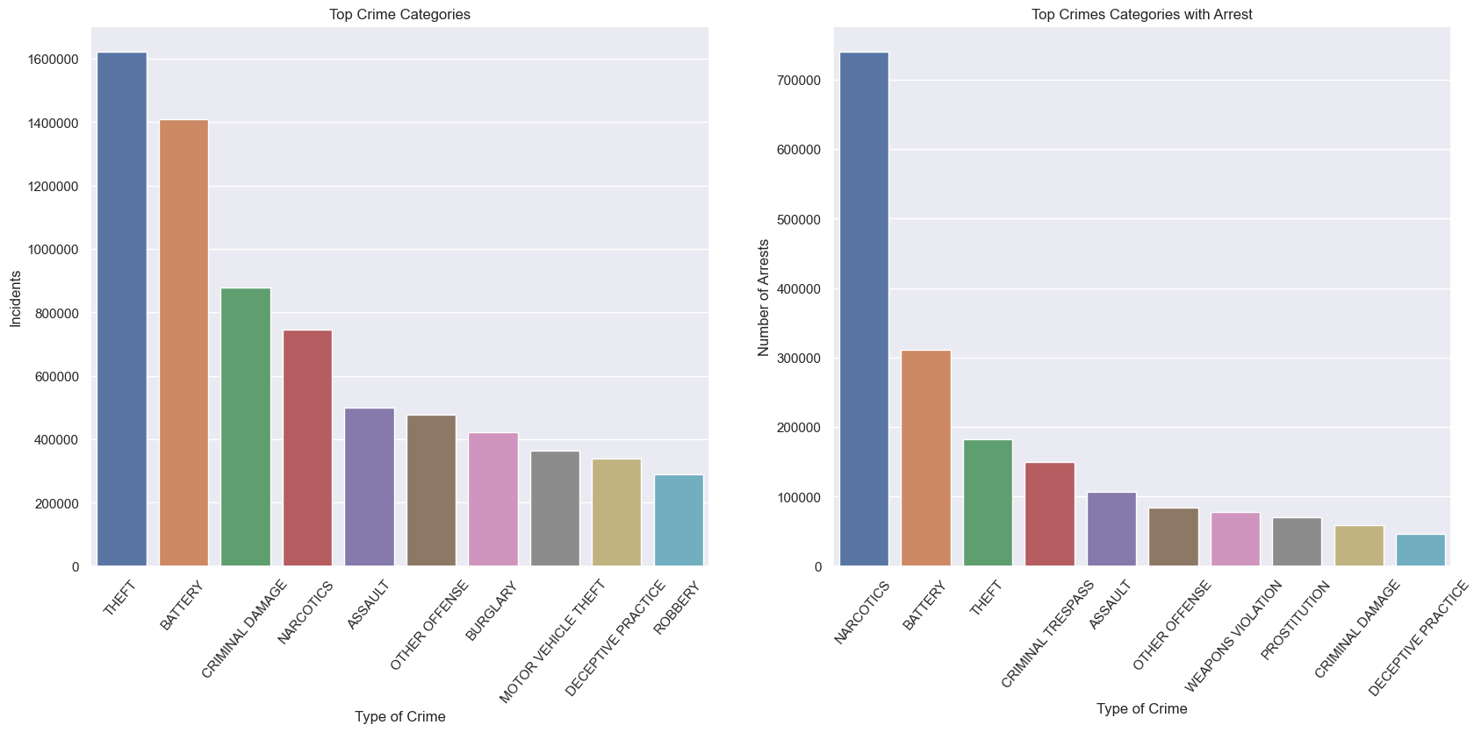
Comparing the Categories of Crimes with those where Arrest is highest.
On comparing list of top crime categories and arrest, it can be concluded that it is not equivalent. Evidently, the crime rate under THEFT is the highest one, but the percentage of arrest is higher in NARCOTICS.

Slide 22
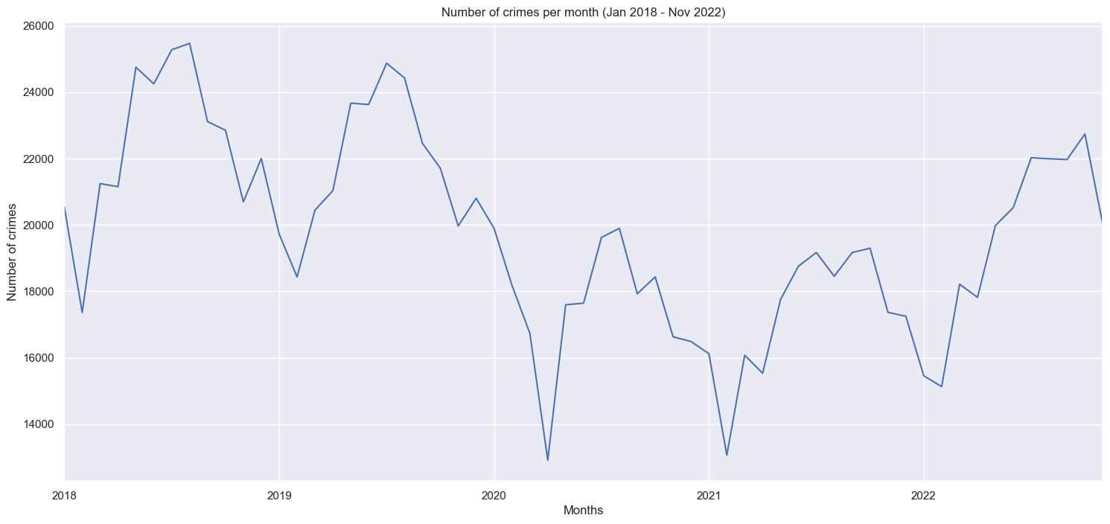
Recent Trends in Crimes happening in Chicago
1. Monthly Crime Trends
On analyzing the recent 4 years trends, it has been found that the frequency of crimes in Chicago is decreasing, with seasonal peaks between June to August, and drops between January to March.

Slide 23
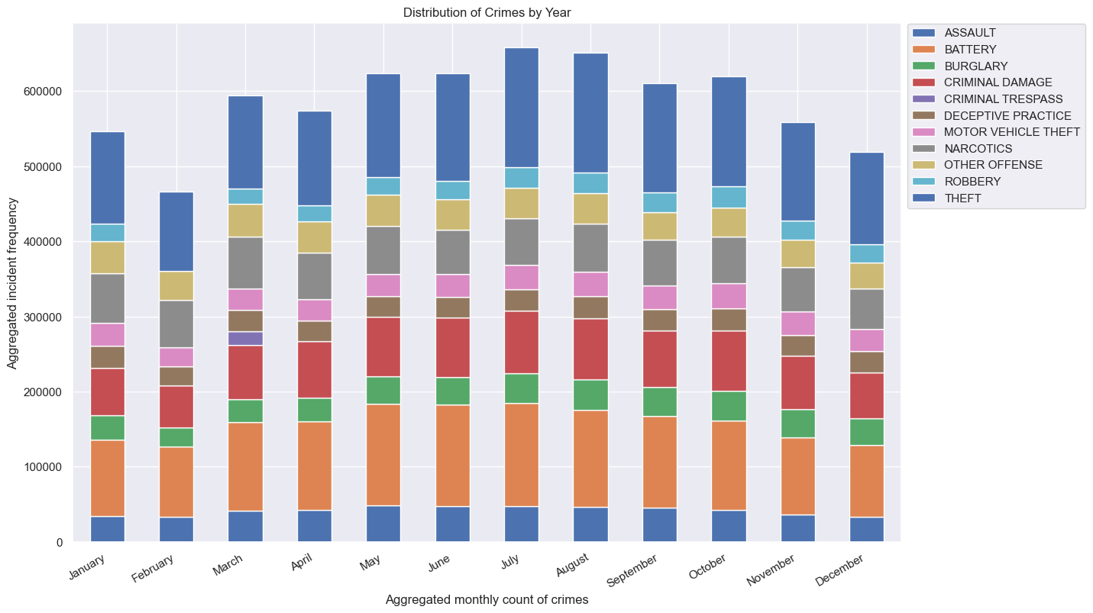
Recent Trends in Crimes happening in Chicago
2. Distribution of categories of crimes over the year
From the above output, it is evident that there is no major variation in the categories of the crime throughout the year.

Slide 24
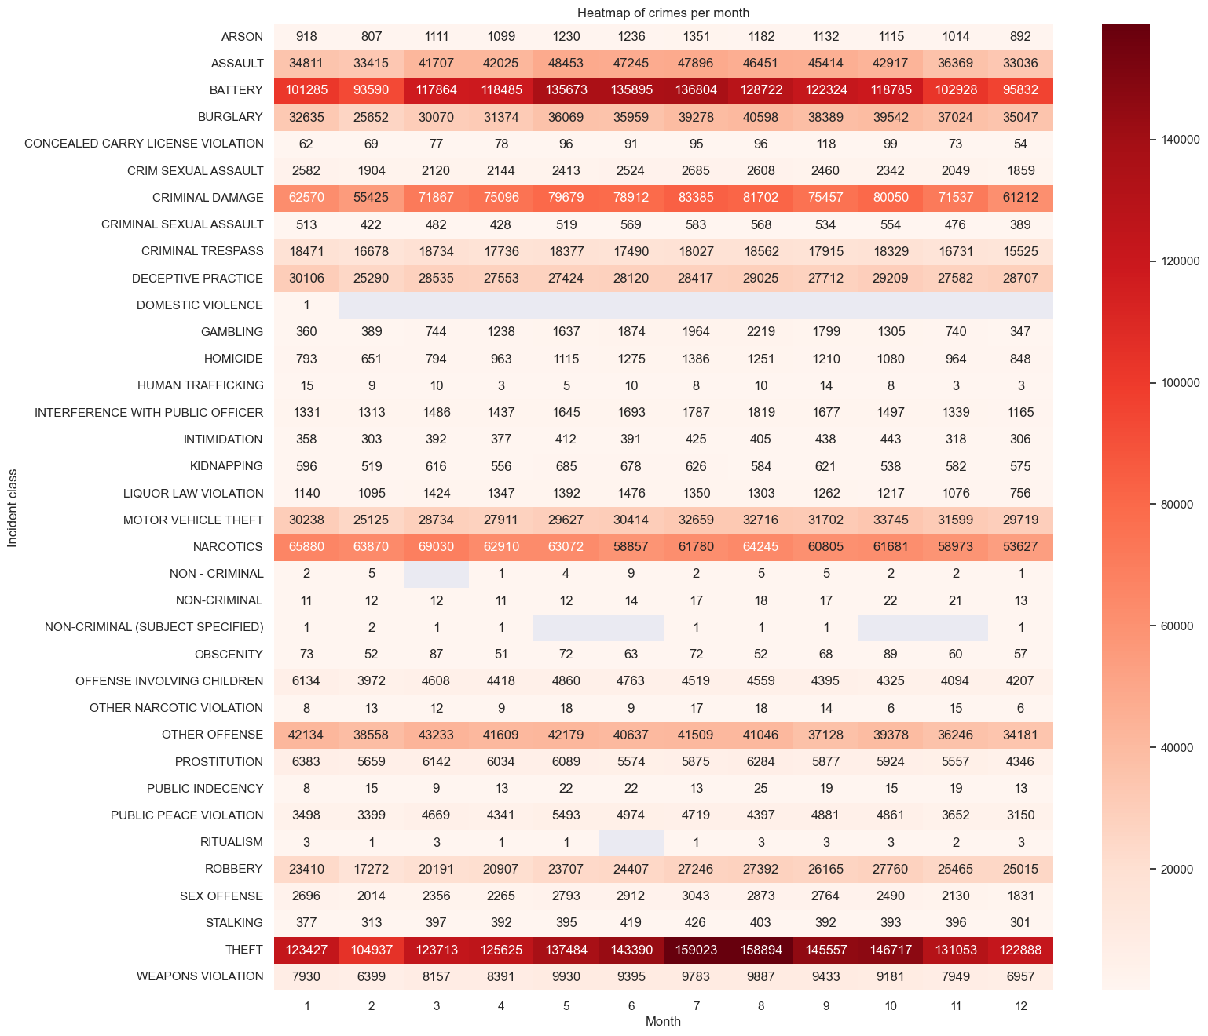
Time-series trends using Heatmaps
Heatmaps is giving evidences to all the previous observations. Firstly, the most dark red regions display the most prominent crime categories of Chicago. Moreover, a change in the color is observable during the middle months of the year, which are July and August. Thus, we are found that the number of crimes occur mostly in July and August.

Slide 25
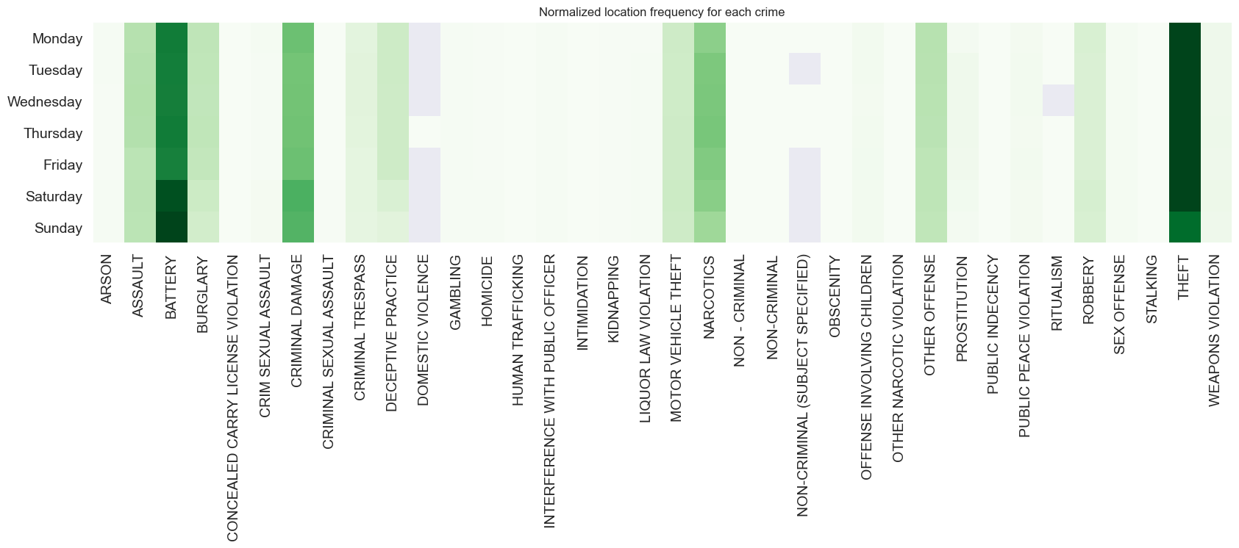
Analyzing days of week with the categories of the crime.
As shown, BATTERY crime and CRIMINAL DAMAGE happens mostly on Saturday and Sunday in comparison to other days of the week. While during the weekdays mostly BURGLARY, DECEPTIVE PRACTICE is intensive. NARCOTICS and THEFT crimes are less frequent on Sunday. The rest types of crimes look distributed similarly during all days of the week.

Slide 26
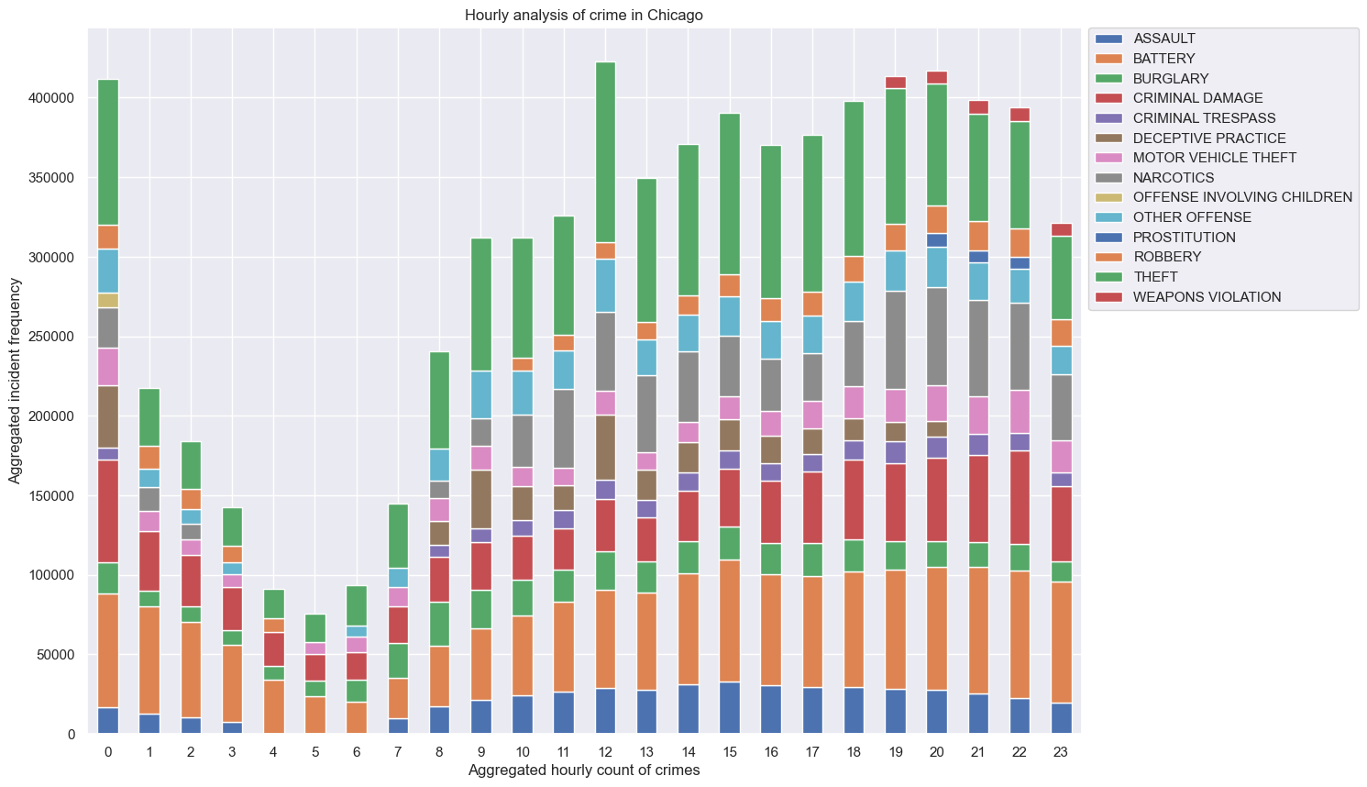
Hourly analysis of crime in Chicago
The analysis of hours states that the safe hours are between 01:00 am and 08:00 am. This trend follows the same pattern for all crime classes.

Slide 27
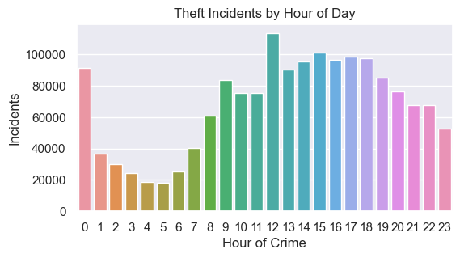
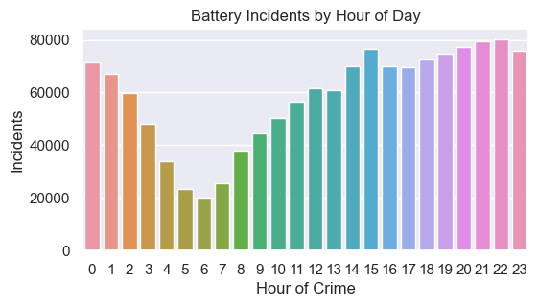
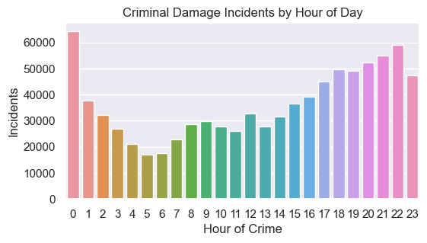
Analyzing top 5 Crime Types over the time of the day
THEFT
THEFT usually occurs in the day time, that said, usually people leave their homes for work or any other activity that leads to theft.
BATTERY
BATTERY crime happens usually in the evening after 2 PM till midnight. Then, it tends to decrease.
CRIMINAL DAMAGE
CRIMINAL DAMAGE usually reported at midnight in comparison to other hours of the day.

Slide 28
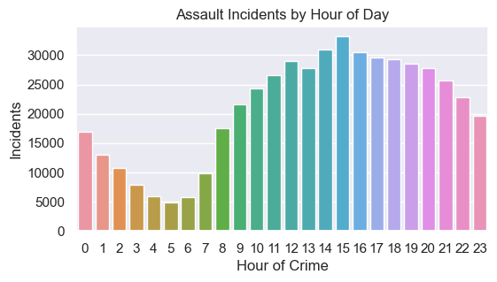
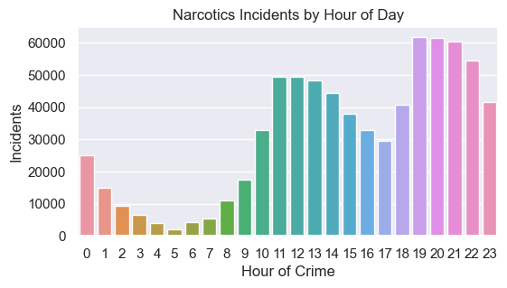
Analyzing top 5 Crime Types over the time of the day
ASSAULT
Mostly Assault is reported during the day hours, this means people are not safe in day hours in comparison to night hours. The police must increase their protection during the day to prevent Assault happenings with the people.
NARCOTICS
NARCOTICS has been reported during the night hours from 7 PM to 11 PM.

Slide 29
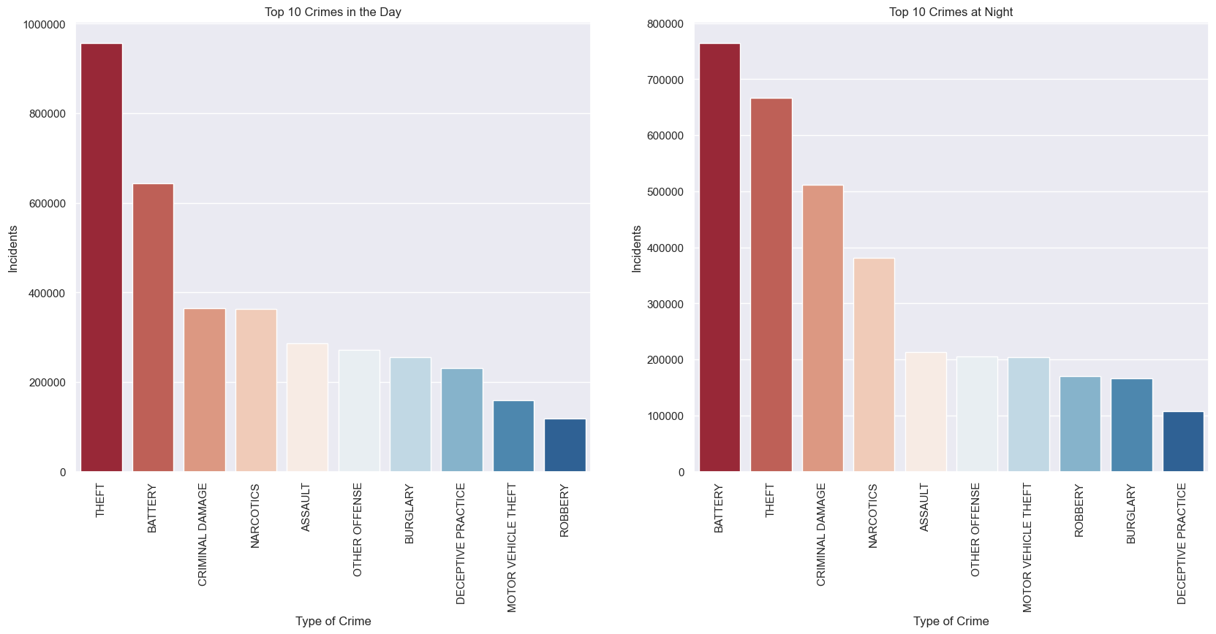
Top 10 crimes in the day vs top 10 crimes at night

Slide 30
Top 10 crimes in the day vs top 10 crimes at night

Slide 31
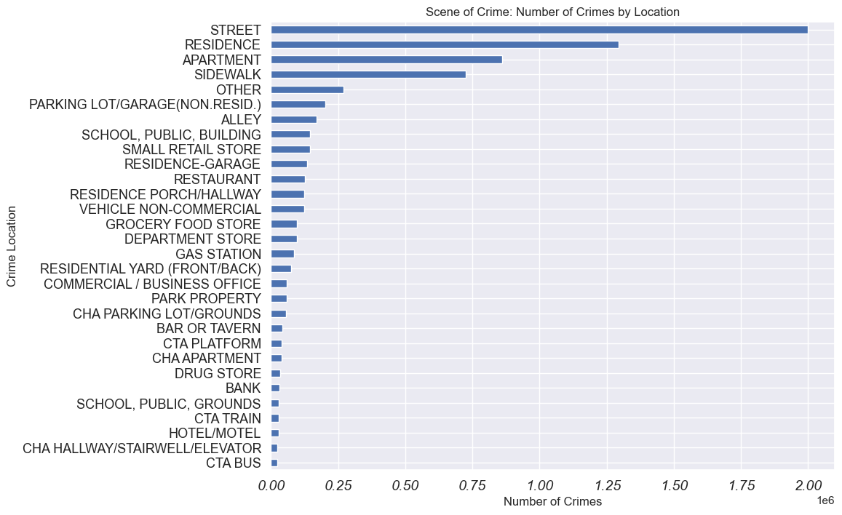
Location Trend Analysis
The most frequent 5 locations of criminal activity are:
STREET
RESIDENCE
APARTMENT
SIDEWALK
OTHER

Slide 32
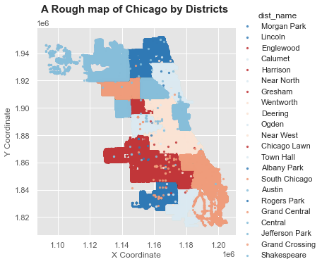
Crimes by Police Districts

Slide 33
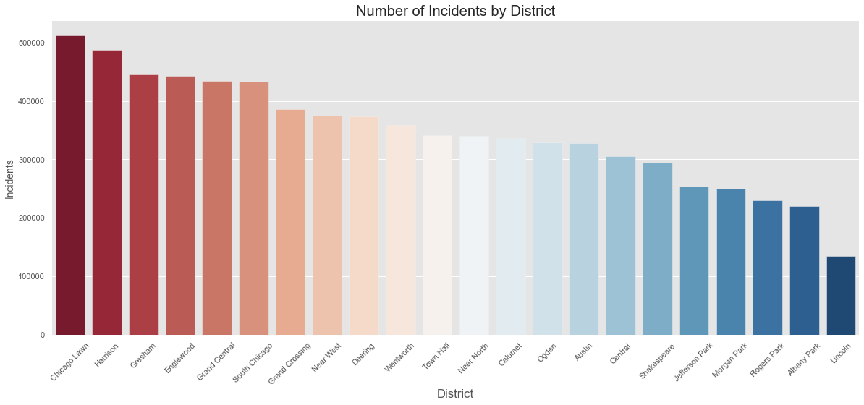
Number of Incidents by Police Districts

Slide 34
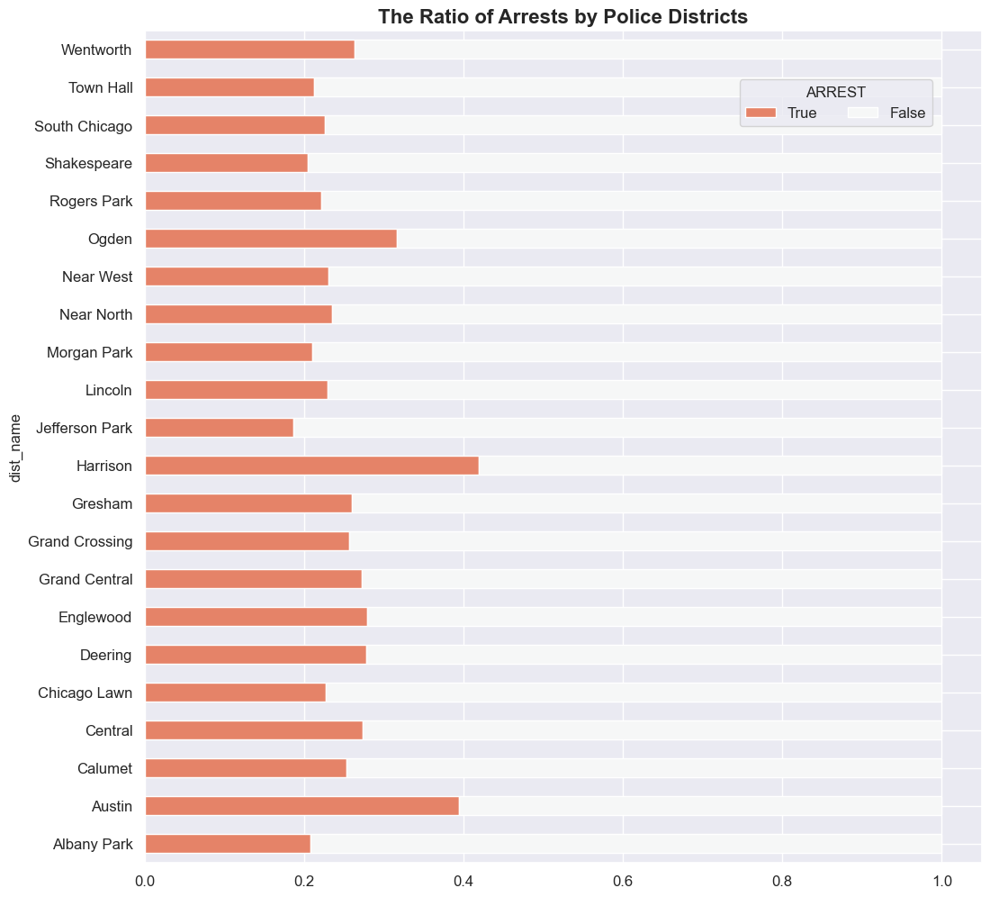
Ratio of Arrests by Police Districts
This analysis clearly tells us that crimes involving “Weapons Violation” & “Concealed Carry License Violation” have a high arrest count. However, for the other crime types, the Chicago police department might want to look into better ways of tackling investigations.

Slide 35
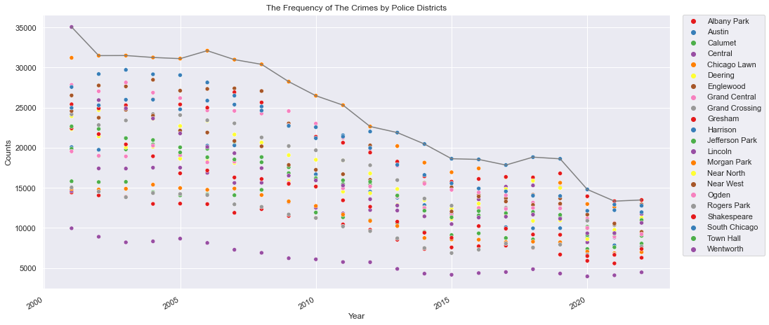
Frequency of Crimes by Police Districts 2001 - 2022

Slide 36
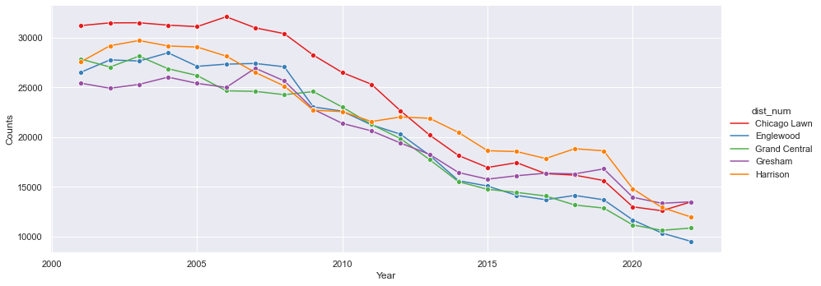
Top 5 Police Districts by Number of Crimes 2001 - 2022

Slide 37
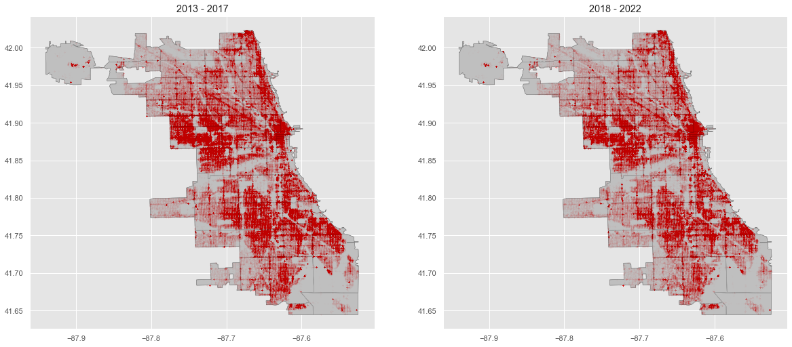
Comparison The Maps of Crimes for The Periods 2013 - 2018 vs 2019 - 2022
The plots show two things:
There is a decrease in crime which is manifested by the lower density of points
The location of the crimes in general are the same

Slide 38
Insights & Recommendations
1. Notable crime rate is higher during the July and August.
A trend we see across our analysis shows that crime rates spike from July – August during the summer period. This can be because during winter it is really cold in Chicago and people usually don't go out much whereas in summer time they go out for enjoying or exploring.
2. Theft is the mostly populated crime in Chicago and it happens during day time.
Crime might spike at this as most of the people leave their homes unattended and theft, bulgary and robbery happens at that time.
From the above to analysis, it is recommended to have a good theft protection system in house as Theft is most prominent crime and it happens during day and in summer months when people are not at home. Therefore, a better protection systems can help us reduce this crime category.
3. Gun related incidents are frequently reported with high arrest rates
From our analysis, we can see that assault and robbery with handguns are the most highly reported incidents in Chicago. This is also coupled with the fact that gun violence is more likely to lead to fatality and people are more inclined to report gun violence as compared to theft or battery.
4. Evidently, the overall percentage of crime is falling, but on the individual analysis we found that major crime categories are rising in last 3-4 years. Therefore, a keen measures should be taken by the police to control each and every crime type.
5. Mostly Assault is reported during the day hours, this means people are not safe in day hours in comparison to night hours. The police must increase their protection during the day to prevent Assault happenings with the people.

Slide 39
THANK YOU

